Slide 1

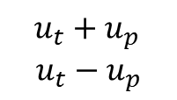


Pitch
State variables
X
Sway PID
Pitch PID
$$u_{p}$$
Sum
$$u_{s}$$
Target X
Cascade
$u_{t}+u_{p}$
$$u_{t}−u_{p}$$
Z
Throttle PID
$$u_{t}$$
Target Z
Parallel

